Slide 1
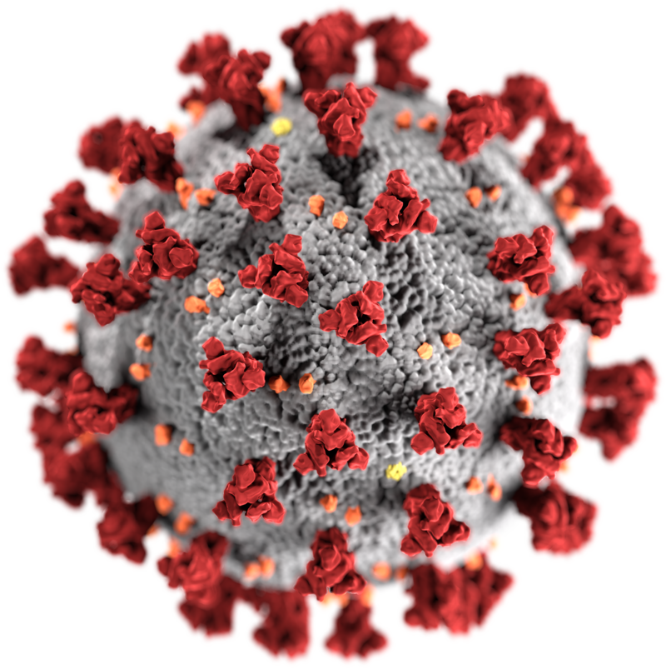
Enhancing COVID-19 Diagnosis Through Deep Learning
Amir Ali
Supervisor
Prof. Jerzy Balicki

Slide 2
Outline
Introduction
Literature Review
Objective of the Study
Data Collection
Methodologies
Result Evaluation
Reference

Slide 3
Introduction
COVID-19 began in late 2019, originating in Wuhan, China, and is caused by the novel coronavirus SARS-CoV-2 [1].
The COVID-19 pandemic has significantly impacted the world, posing challenges to public health and healthcare systems.
Deep learning offers potential solutions to address these challenges.
Our objective is to understand how deep learning techniques can contribute to the accurate and efficient classification of COVID-19 cases.
[1] Y. Shi, G. Wang, X.-p. Cai, J.-w. Deng, L. Zheng, H.-h. Zhu, M. Zheng, B. Yang, and Z. Chen, “An overview of covid-19,” Journal of Zhejiang University. Science. B, vol. 21, no. 5, p. 343, 2020

Slide 4
Literature Review
Origin of COVID-19
Structure of COVID-19
Variants of COVID-19
Radiographic Diagnosis for COVID-19

Slide 5
Origin of COVID-19
The first cases of COVID-19 were linked to a seafood market in Wuhan, where live animals were also sold.
Initial investigations suggested that the virus likely originated in bats and was potentially transmitted to humans through an intermediate animal host.
As the virus spread, it quickly became evident that human-to-human transmission was a significant factor in the pandemic's expansion.

Slide 6
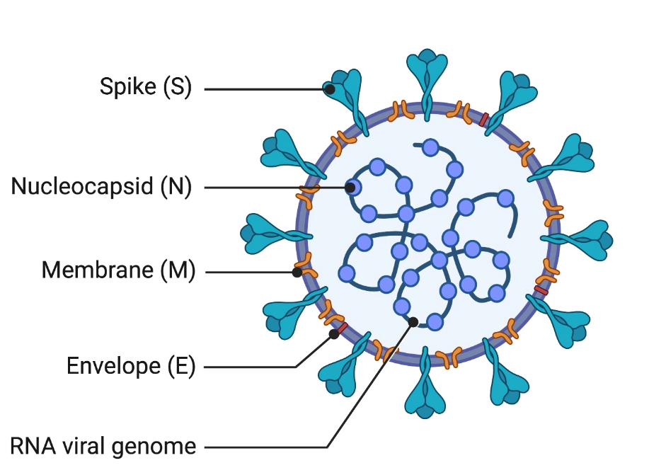
Structure of COVID-19
Spike Proteins: These proteins on the virus's surface help it enter and infect human cells.
Nucleocapsid: It is a protein-RNA complex inside the virus that protects its genetic material and aids in replication.
Membrane Proteins: These proteins are embedded in the viral envelope and play a role in maintaining the virus's structure.
Envelope: It is a lipid layer surrounding the virus, providing protection and containing spike and membrane proteins.
RNA Viral Genome: COVID-19 has a single-stranded RNA as its genetic material, containing instructions for viral replication and protein production.
Fig 1: Structure of COVID-19 [2]
[2] J. King, M. Kosinski-Collins, and E. Sunderberg, “Coronavirus structure, vaccine and therapy development,” Biophysical society, 2020.

Slide 7
Variants of COVID-19
Alpha Variant (B.1.1.7)
Beta Variant (B.1.351)
Gamma Variant (P.1)
Delta Variant (B.1.617.2)
Omicron Variant (B.1.1.529)

Slide 8
Radiographic Diagnosis for COVID-19
Chest X-ray
Computed tomography(CT) Scans
Ultrasound
Magnetic resonance imaging(MRI) Scan

Slide 9
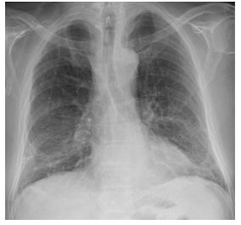
Chest X-ray for COVID-19
Chest X-rays are used to look for lung abnormalities caused by COVID-19.
They show cloudy or patchy areas in the lungs, indicating possible infection.
X-rays are helpful but not definitive for COVID-19 diagnosis. Other tests are needed for confirmation.
X-rays provide important information about how much the lungs are affected by COVID-19 and how severe the infection is.
Fig 2: X-rays of COVID-19 Patient [3]
[3] “Bolton NHS partners with Qure.ai for monitoring of COVID-19 patients — mobihealthnews.com.” https://www.mobihealthnews.com/news/bolton-nhs-partners-qureai-monitoring-covid-19-patients.

Slide 10
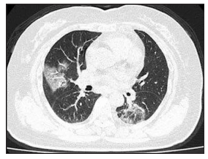
CT Scans for COVID-19
CT scans show detailed images of the lungs to help diagnose and assess COVID-19.
They can detect lung abnormalities related to the virus.
CT scans are used alongside other tests to evaluate the severity of the infection.
However, they involve radiation and should be used carefully.
Fig 3: CT Scans of COVID-19 Patient [4]
[4] Radiology Lessons for Coronavirus From the SARS and MERS Epidemics — itnonline.com.” https://www.itnonline.com/article/radiology-lessons-coronavirus-sars-and-mers-epidemics.

Slide 11
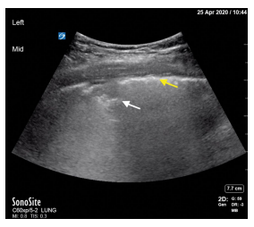
Ultrasound for COVID-19
Ultrasound helps assess lung and heart involvement in COVID-19.
It detects characteristic findings like B-lines, indicating lung congestion or fluid accumulation.
It provides real-time imaging, allowing for rapid evaluation of lung involvement.
Fig 4: Ultrasound of COVID-19 Patient [5]
[5] K. Jackson, R. Butler, and A. Aujayeb, “Lung ultrasound in the covid-19 pandemic, ”Postgraduate medical journal, vol. 97, no. 1143, pp. 34–39, 2021

Slide 12
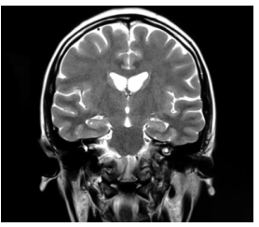
MRI for COVID-19
MRI scans may be used to assess complications or related conditions associated with COVID-19, such as pulmonary embolism or myocardial injury.
MRI scans are not as readily available and can be more time-consuming and expensive compared to other imaging techniques like CT scans.
MRI scans have a limited role in the direct diagnosis of COVID-19. Other imaging modalities like CT scans or X-rays are more commonly used for this purpose.
Fig 5: X-rays of COVID-19 Patient [6]
[6] N. Mathur, “MRI shows brain microstructural changes after mild COVID-19 — news-medical.net.” https://www.news-medical.net/news/20220825/MRI-shows-brain-microstructural-changes-after-mild-COVID-19

Slide 13
Objective of the Study
Radiographic Diagnosis COVID-19 Images
Integrating Radiographic Diagnosis Images with Deep Learning Methods for Accurate Classification of COVID-19 Cases
Deep Learning Techniques
COVID-19 Classification

Slide 14
Data Collection
Extensive COVID-19 X-Ray and CT Chest Images Dataset
SARS-COV-2 CT-Scan Dataset
COVID-QU-Ex Dataset

Slide 15
Extensive COVID-19 X-Ray and CT Chest Images Dataset
Collected from Menoufia University [7]
Dataset Consists of both X-ray and CT images
9544 X-ray Images
  5500 Non-Covid
  4044 Covid
8055 CT Images
  2628 Non-Covid
  5427 Covid
[7] W. El-Shafai and F. Abd El-Samie, “Extensive covid-19 x-ray and ct chest images dataset,” Mendeley data, vol. 3, no. 10, 2020

Slide 16
SAR-COV-2 CT Scan Dataset
Collected from San Paulo Hospital located in Brazil [8]
Dataset Consists of 2482 CT images
  1252 COVID
  1230 Non-Covid
[8] E. Soares, P. Angelov, S. Biaso, M. H. Froes, and D. K. Abe, “Sars-cov-2 ct-scan dataset: A large dataset of real patients ct scans for sars-cov-2 identification,” MedRxiv, pp. 2020–04, 2020

Slide 17
COVID-QU-Ex Dataset
Collected from Qatar University in collaboration with Doha, and the University of Dhaka [9-12].
Dataset Consists of 19312 X-ray images
  10192 Non-Covid
  9121 Covid-Images
[9] A. M. Tahir, M. E. Chowdhury, A. Khandakar, T. Rahman, Y. Qiblawey, U. Khur-shid, S. Kiranyaz, N. Ibtehaz, M. S. Rahman, S. Al-Maadeed, et al., “Covid-19 infection localization and severity grading from chest x-ray images,” Computers in
biology and medicine, vol. 139, p. 105002, 2021
[10] Rahman, A. Khandakar, Y. Qiblawey, A. Tahir, S. Kiranyaz, S. B. A. Kashem, M. T. Islam, S. Al Maadeed, S. M. Zughaier, M. S. Khan, et al., “Exploring the effect of image enhancement techniques on covid-19 detection using chest
x-ray images,” Computers in biology and medicine, vol. 132, p. 104319, 2021.
[11] A. Degerli, M. Ahishali, M. Yamac, S. Kiranyaz, M. E. Chowdhury, K. Hameed, T. Hamid, R. Mazhar, and M. Gabbouj, “Covid-19 infection map generation and detection from chest x-ray images,
” Health information science and systems, vol. 9, no. 1, p. 15, 2021.
[12] M. E. Chowdhury, T. Rahman, A. Khandakar, R. Mazhar, M. A. Kadir, Z. B. Mahbub, K. R. Islam, M. S. Khan, A. Iqbal, N. Al Emadi, et al., “Can ai help in
screening viral and covid-19 pneumonia?,” Ieee Access, vol. 8, pp. 132665–132676, 2020.

Slide 18
Methodologies
CNN
DenseNet
DenseNet121
DenseNet169
DenseNet201
VGG
VGG16
VGG19
Inception
Inception V3
Inception V4
AlexNet
ResNet 50

Slide 19
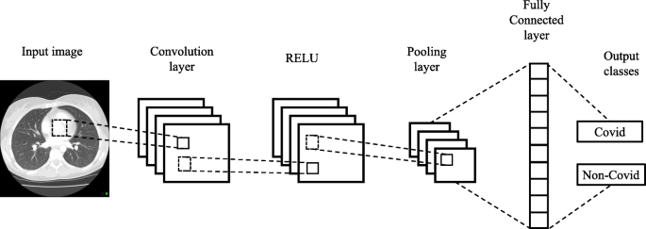
CNN
Fig 6: Architecture of CNN [13]
[13] Haque, Khandaker F., and Ahmed Abdelgawad. "A Deep Learning Approach to Detect COVID-19 Patients from Chest X-ray Images." AI 1, no. 3 (2020): 418-435. Accessed June 12, 2023.
https://doi.org/10.3390/ai1030027.

Slide 20
DenseNet
Concept of densely connected convolutional layers
Composed of multiple dense blocks
Model uses a combination of convolutional, pooling, and fully connected layers.
DenseNet121 has 121 layers in total, making it a relatively deep and powerful network.
DenseNet169 has a higher number of layers, with a total of 169 layers, making it a deeper network compared to DenseNet121.
DenseNet201 has the highest number of layers among the three, with a total of 201 layers, making it the deepest network in the DenseNet series.

Slide 21
VGG
It was developed by the Visual Geometry Group at the University of Oxford.
VGG consists of a series of convolutional layers, followed by fully connected layers at the end.
VGG16 has a total of 16 layers, including 13 convolutional layers and 3 fully connected layers.
VGG19 has a deeper architecture than VGG16, with additional convolutional layers and parameters.

Slide 22
Inception
Characterized by their unique architecture that incorporates multiple parallel convolutional layers.
Designed to strike a balance between model complexity and computational efficiency.
Different versions of the Inception models, such as Inception V1, V2, V3, V4.
InceptionV3: Efficient and accurate image classification with a balanced architecture.
InceptionV4: Advanced performance in image recognition with residual connections and factorized convolutions.

Slide 23
AlexNet
AlexNet: Pioneering deep learning model for image classification, winning the 2012 ILSVRC.
8 layers: 5 convolutional, 3 fully connected.
Introduced ReLU activation and dropout regularization.
Trained on large-scale ImageNet dataset.

Slide 24
Result Evaluation
Models |  | CT Scan Dataset (Accuracy) | X-rays Dataset (Accuracy)
CNN | CNN | 99.90% | 95.20%
DenseNet | DenseNet121 | 99.90% | 91.89%
 | DenseNet169 | 99.80% | 90.80%
 | DenseNet201 | 99.70% | 88.95%
VGG | VGG16 | 99.90%
 | VGG16 | 99.80%
Inception | Inception V3
 | Inception V4
AlexNet
Resnet50

Slide 25
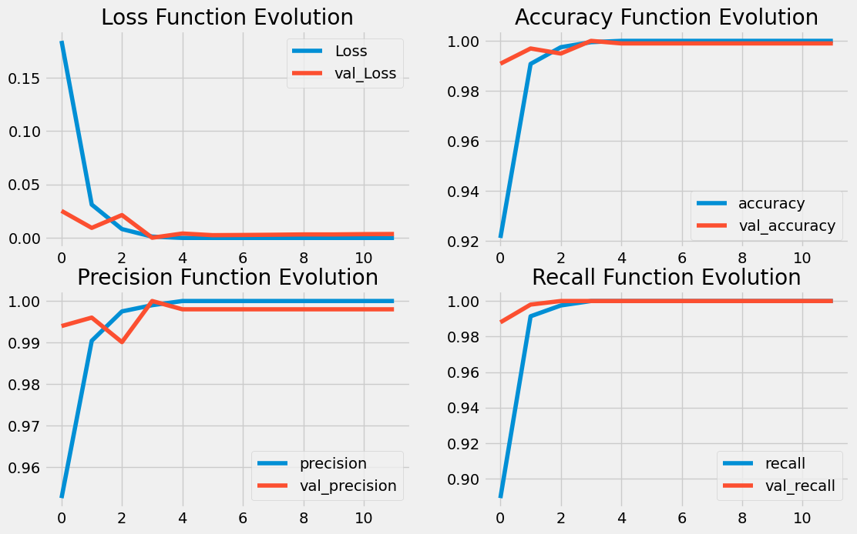
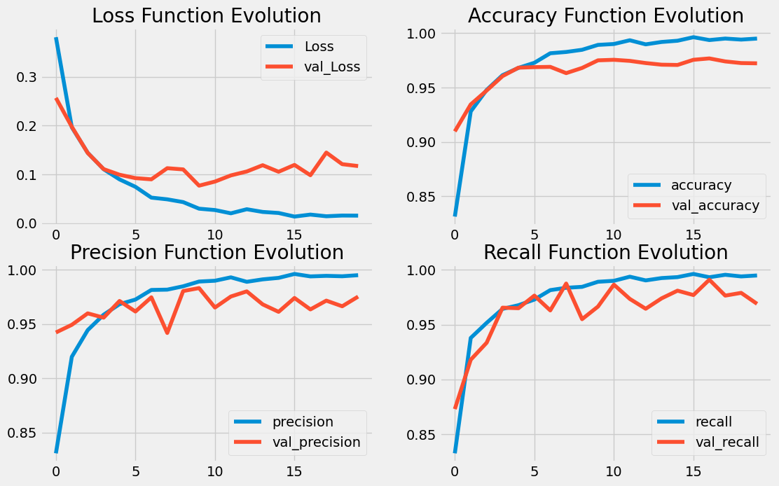
Result of CNN Model
Result of CT Dataset
Result of X-ray Dataset

Slide 26
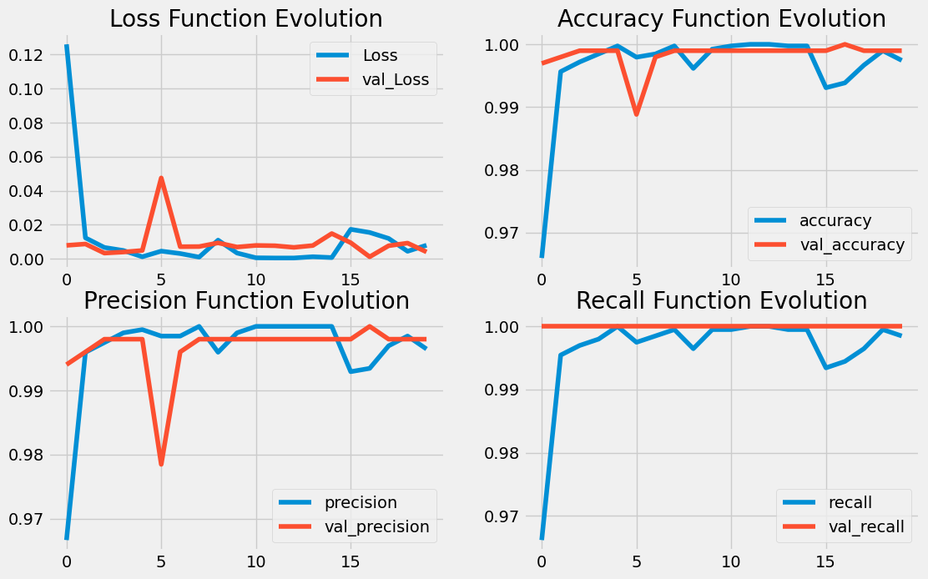
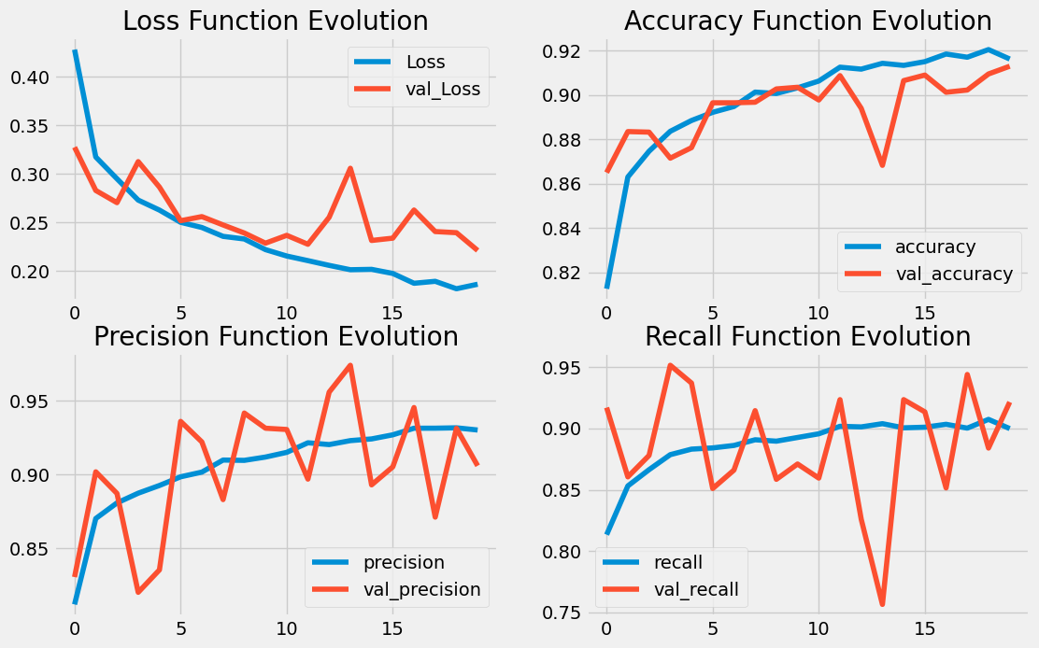
Result of DenseNet121
Result of CT Dataset
Result of X-ray Dataset

Slide 27
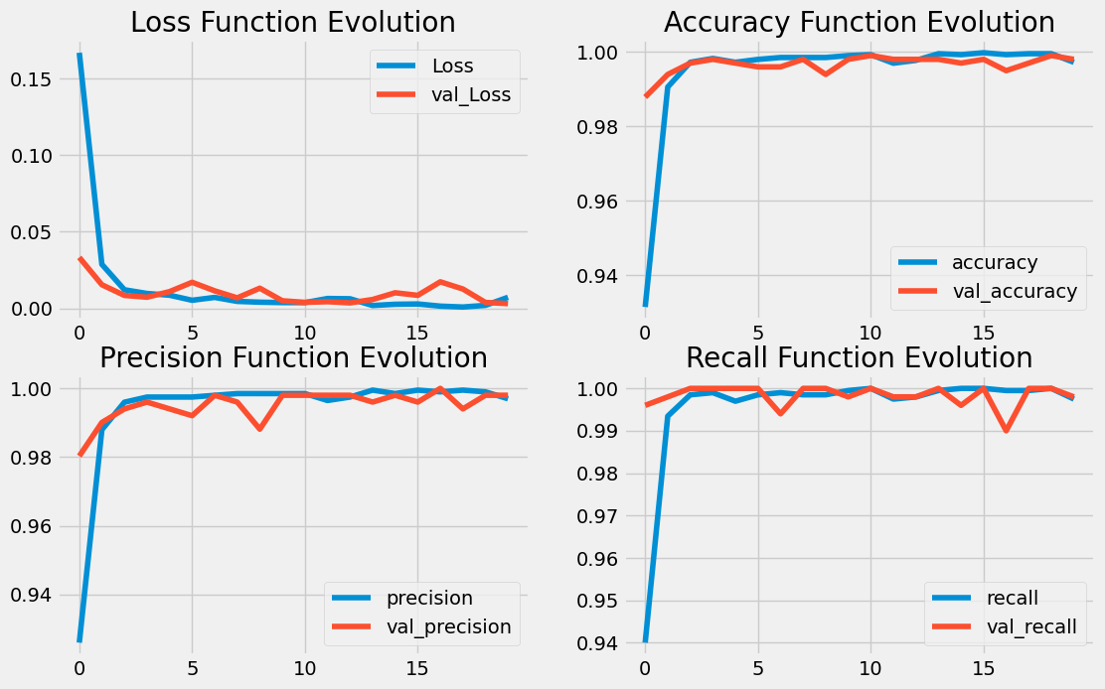
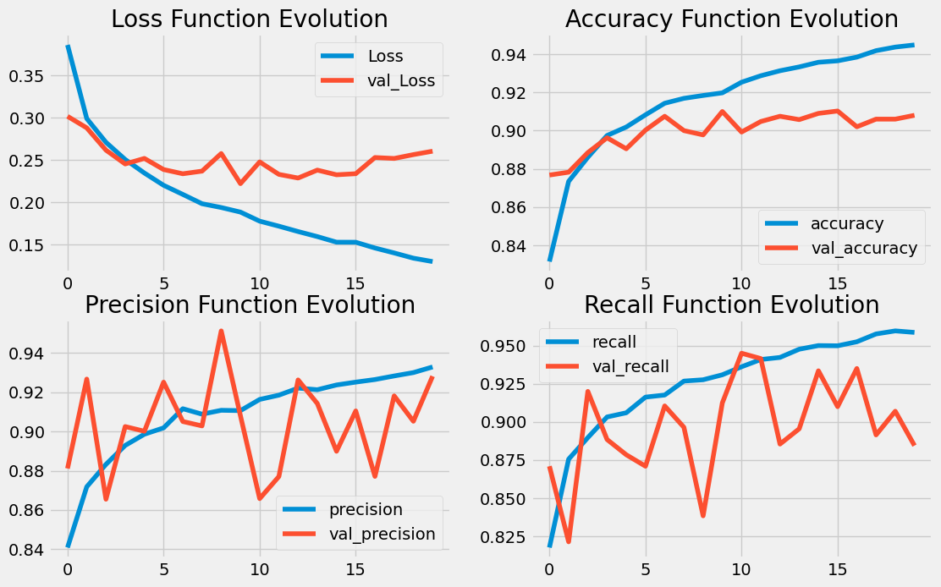
Result of DenseNet169
Result of CT Dataset
Result of X-ray Dataset

Slide 28
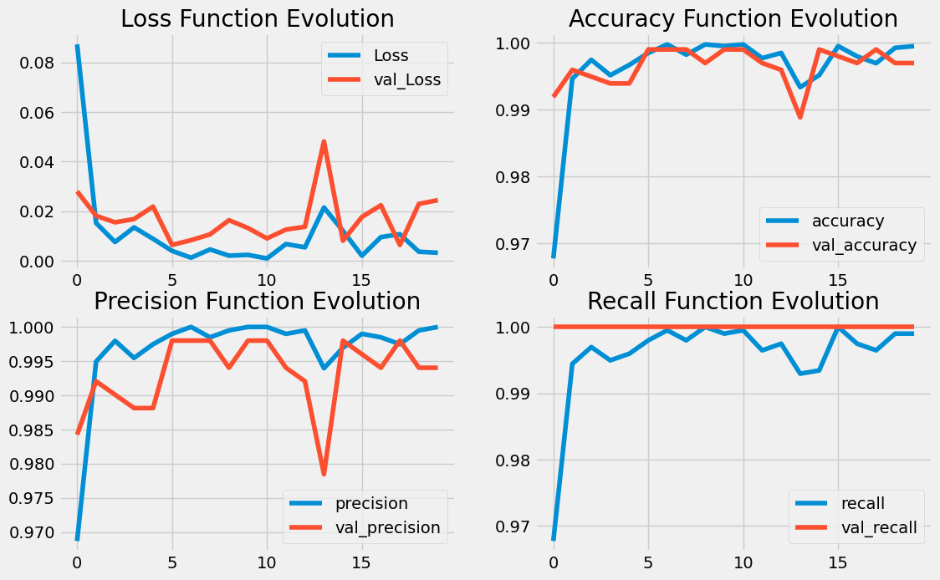
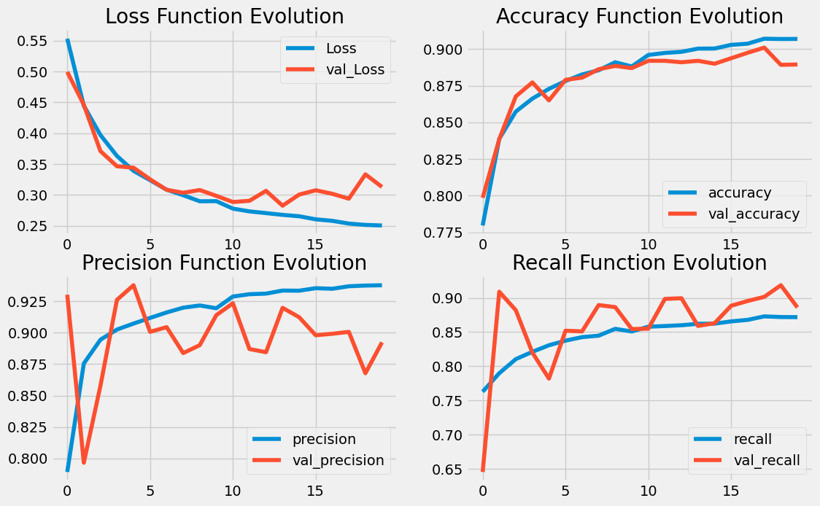
Result of DenseNet201
Result of CT Dataset
Result of X-ray Dataset

Slide 29
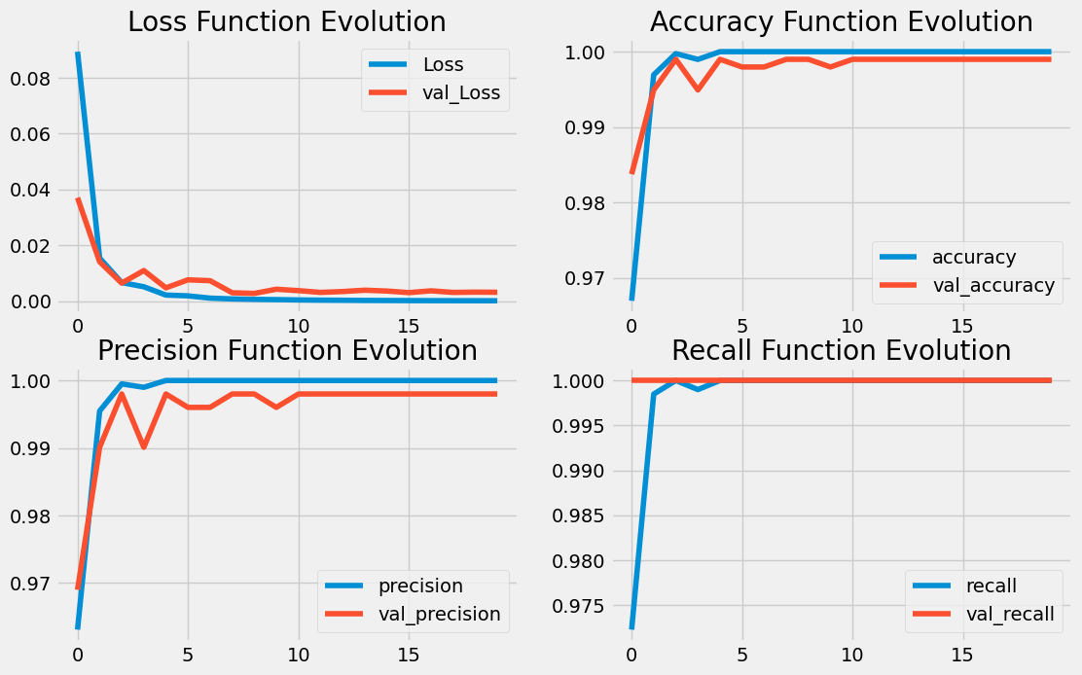
Result of VGG16
Result of CT Dataset

Slide 30
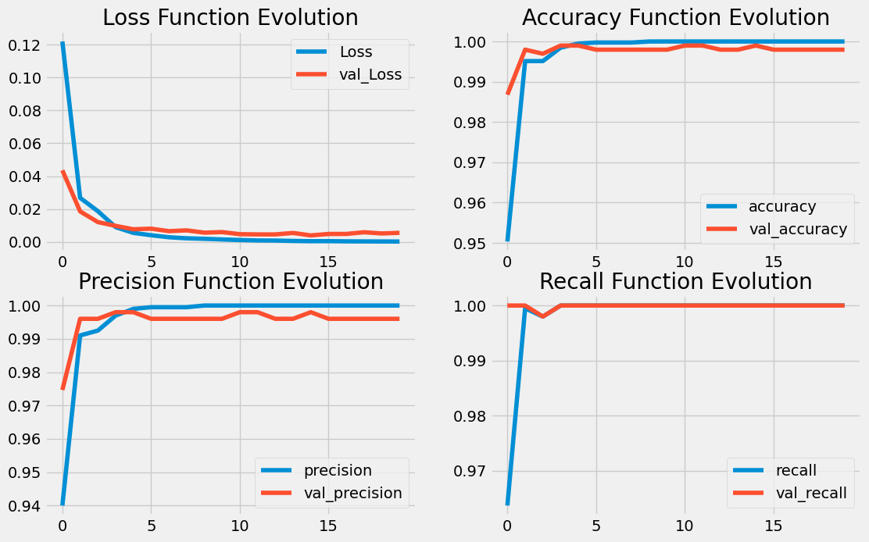
Result of VGG19
Result of CT Dataset

Slide 31
Reference
[1] Y. Shi, G. Wang, X.-p. Cai, J.-w. Deng, L. Zheng, H.-h. Zhu, M. Zheng, B. Yang, and Z. Chen, “An overview of covid-19,” Journal of Zhejiang University. Science. B, vol. 21, no. 5, p. 343, 2020
[2] J. King, M. Kosinski-Collins, and E. Sunderberg, “Coronavirus structure, vaccine and therapy development,” Biophysical society, 2020.
[3] “Bolton NHS partners with Qure.ai for monitoring of COVID-19 patients — mobihealthnews.com.” https://www.mobihealthnews.com/news/bolton-nhs-partners-qureai-monitoring-covid-19-patients.
[4] Radiology Lessons for Coronavirus From the SARS and MERS Epidemics — itnonline.com.” https://www.itnonline.com/article/radiology-lessons-coronavirus-sars-and-mers-epidemics.
[5] K. Jackson, R. Butler, and A. Aujayeb, “Lung ultrasound in the covid-19 pandemic, ”Postgraduate medical journal, vol. 97, no. 1143, pp. 34–39, 2021
[6] N. Mathur, “MRI shows brain microstructural changes after mild COVID-19 — news-medical.net.” https://www.news-medical.net/news/20220825/MRI-shows-brain-microstructural-changes-after-mild-COVID-19
[7] W. El-Shafai and F. Abd El-Samie, “Extensive covid-19 x-ray and ct chest images dataset,” Mendeley data, vol. 3, no. 10, 2020
[8] E. Soares, P. Angelov, S. Biaso, M. H. Froes, and D. K. Abe, “Sars-cov-2 ct-scan dataset: A large dataset of real patients ct scans for sars-cov-2 identification,” MedRxiv, pp. 2020–04, 2020

Slide 32
Reference
[9] A. M. Tahir, M. E. Chowdhury, A. Khandakar, T. Rahman, Y. Qiblawey, U. Khur-shid, S. Kiranyaz, N. Ibtehaz, M. S. Rahman, S. Al-Maadeed, et al., “Covid-19 infection localization and severity grading from chest x-ray images,” Computers in biology and medicine, vol. 139, p. 105002, 2021
[10] Rahman, A. Khandakar, Y. Qiblawey, A. Tahir, S. Kiranyaz, S. B. A. Kashem, M. T. Islam, S. Al Maadeed, S. M. Zughaier, M. S. Khan, et al., “Exploring the effect of image enhancement techniques on covid-19 detection using chestx-ray images,” Computers in biology and medicine, vol. 132, p. 104319, 2021.
[11] A. Degerli, M. Ahishali, M. Yamac, S. Kiranyaz, M. E. Chowdhury, K. Hameed, T. Hamid, R. Mazhar, and M. Gabbouj, “Covid-19 infection map generation and detection from chest x-ray images,” Health information science and systems, vol. 9, no. 1, p. 15, 2021.
[12] M. E. Chowdhury, T. Rahman, A. Khandakar, R. Mazhar, M. A. Kadir, Z. B. Mahbub, K. R. Islam, M. S. Khan, A. Iqbal, N. Al Emadi, et al., “Can ai help inscreening viral and covid-19 pneumonia?,” Ieee Access, vol. 8, pp. 132665–132676, 2020.
[13] Haque, Khandaker F., and Ahmed Abdelgawad. "A Deep Learning Approach to Detect COVID-19 Patients from Chest X-ray Images." AI 1, no. 3 (2020).https://doi.org/10.3390/ai1030027.

Slide 33
Thank You☺
Any Questions?

